Slide 1
Substance Abuse and Non-Suicidal Self-Injury
(NSSI)
Warren Boykin
(warren.boykin@gmail.com)
IBEI
May 24, 2022

Slide 2
Why do Teens Use Drugs?
The teen years are often a time to explore and learn more about themselves as they approach adulthood. Often, this involves experimenting and testing their boundaries. The desire to do something new or risky is a normal part of teen development.
Teens who perceive little risk in using drugs are more likely to use drugs. Teens may also use drugs or alcohol to:
Relieve boredom
Feel good
Forget their troubles and relax
Satisfy their curiosity
Ease their pain
Feel grown up
Show their independence
Belong to a specific group

Slide 3
What are the Risk Factors and Protective Factors for Drug Use?
Many factors influence a child’s likelihood to use illegal substances or develop a substance abuse disorder. Effective drug prevention focuses on reducing the risk factors and strengthening the protective factors that are most closely related to substance abuse.
Risk factors are circumstances or events that increase a child’s use and abuse of drugs. The more risk factors present, the more likely a child may be to use drugs and develop problems. Risk factors for drug use include:

Slide 4
Risk Factors
Low grades or failure in school
Victim of bullying or cyberbullying
Low self esteem
Permissive parenting
Parent or older sibling drug/alcohol use
Living in a community with a high tolerance for smoking, drinking, or drug use among youth
Attending a school without strict rules for tobacco, alcohol, or drugs and inconsistent enforcement for breaking those rules
Belief that there is little risk in using a drug.

Slide 5
Protective Factors
Protective factors are those characteristics that can reduce a person's risk for substance abuse or addiction. Protective factors that may decrease the risk of drug use include:
Strong bond with a parent or caregiver
High self esteem
Parent or caregiver who talks regularly with their child about drugs
Active in faith-based organizations, school, athletic, or community activities
Spending time around positive role models
Living in a community that offers youths activities where drugs and alcohol are not tolerated
Attending a school with an effective alcohol and drug education program and a non-tolerance policy for alcohol and drugs
Belief that using drugs may be harmful or risky
https://www.getsmartaboutdrugs.gov/family/why-do-teens-use-drugs

Slide 6
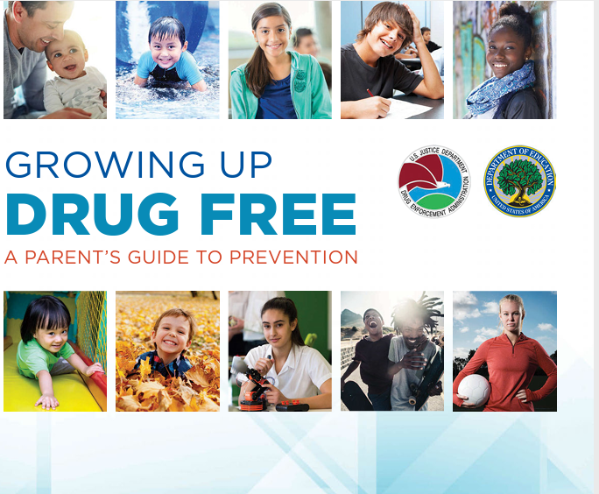
Prevention – Cont.
As a parent you can control many of the risk and protective factors in your home. Remember that parents and caregivers are the most important role models in children’s lives. For more information see Growing up Drug Free: A Parent’s Guide to Prevention.

Slide 7
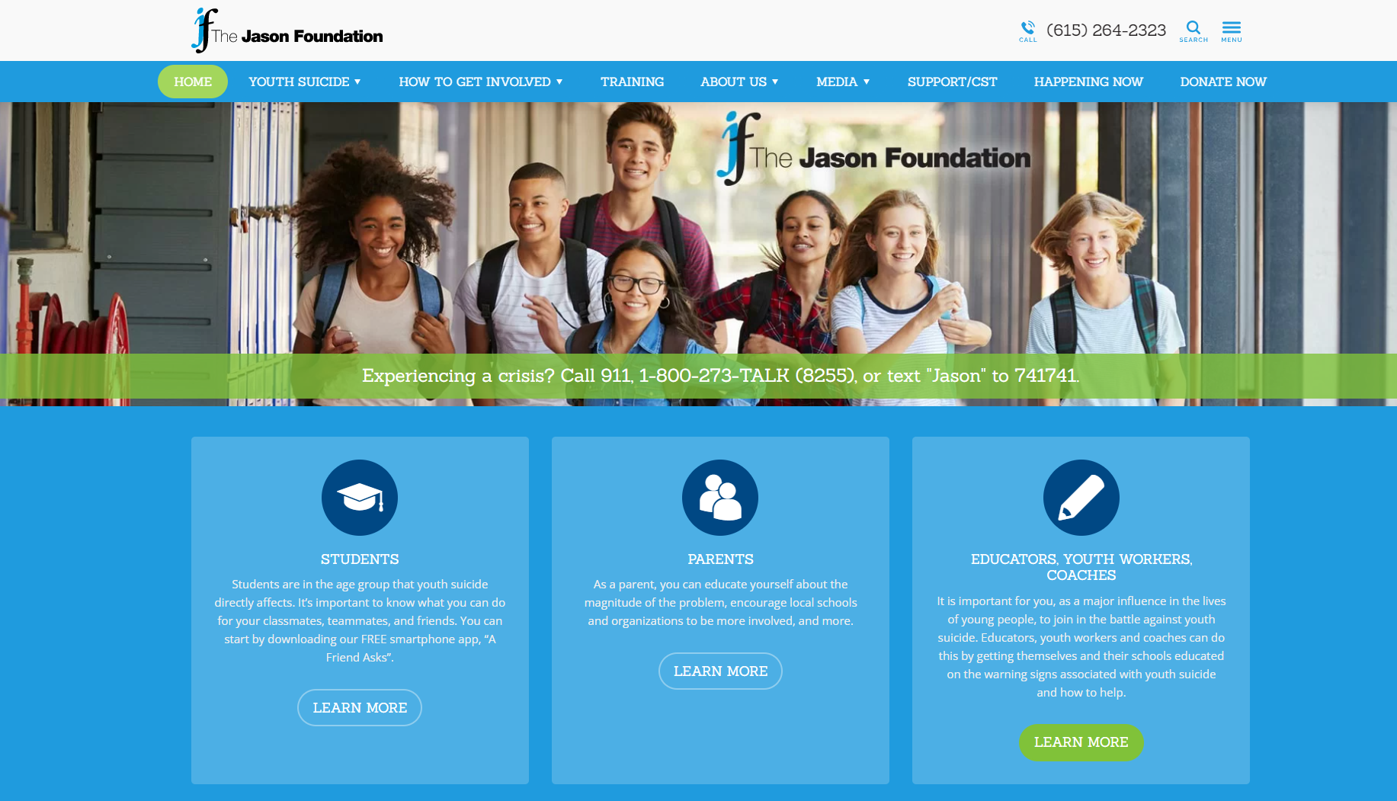
Notes:
https://jasonfoundation.com/

Slide 8
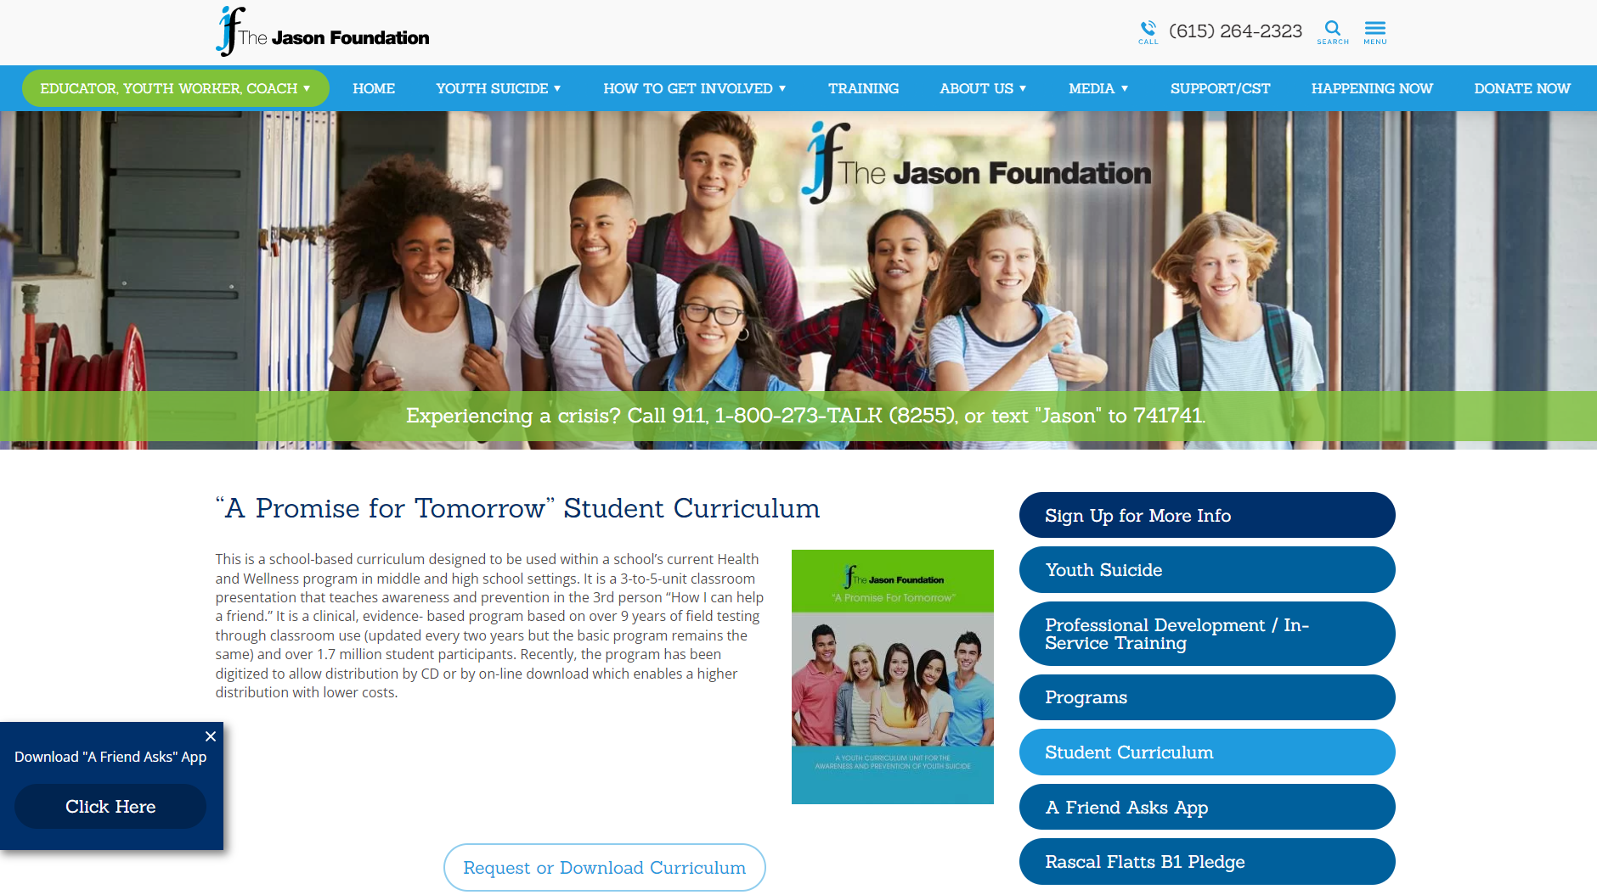
Notes:
Student Curriculum

Slide 9
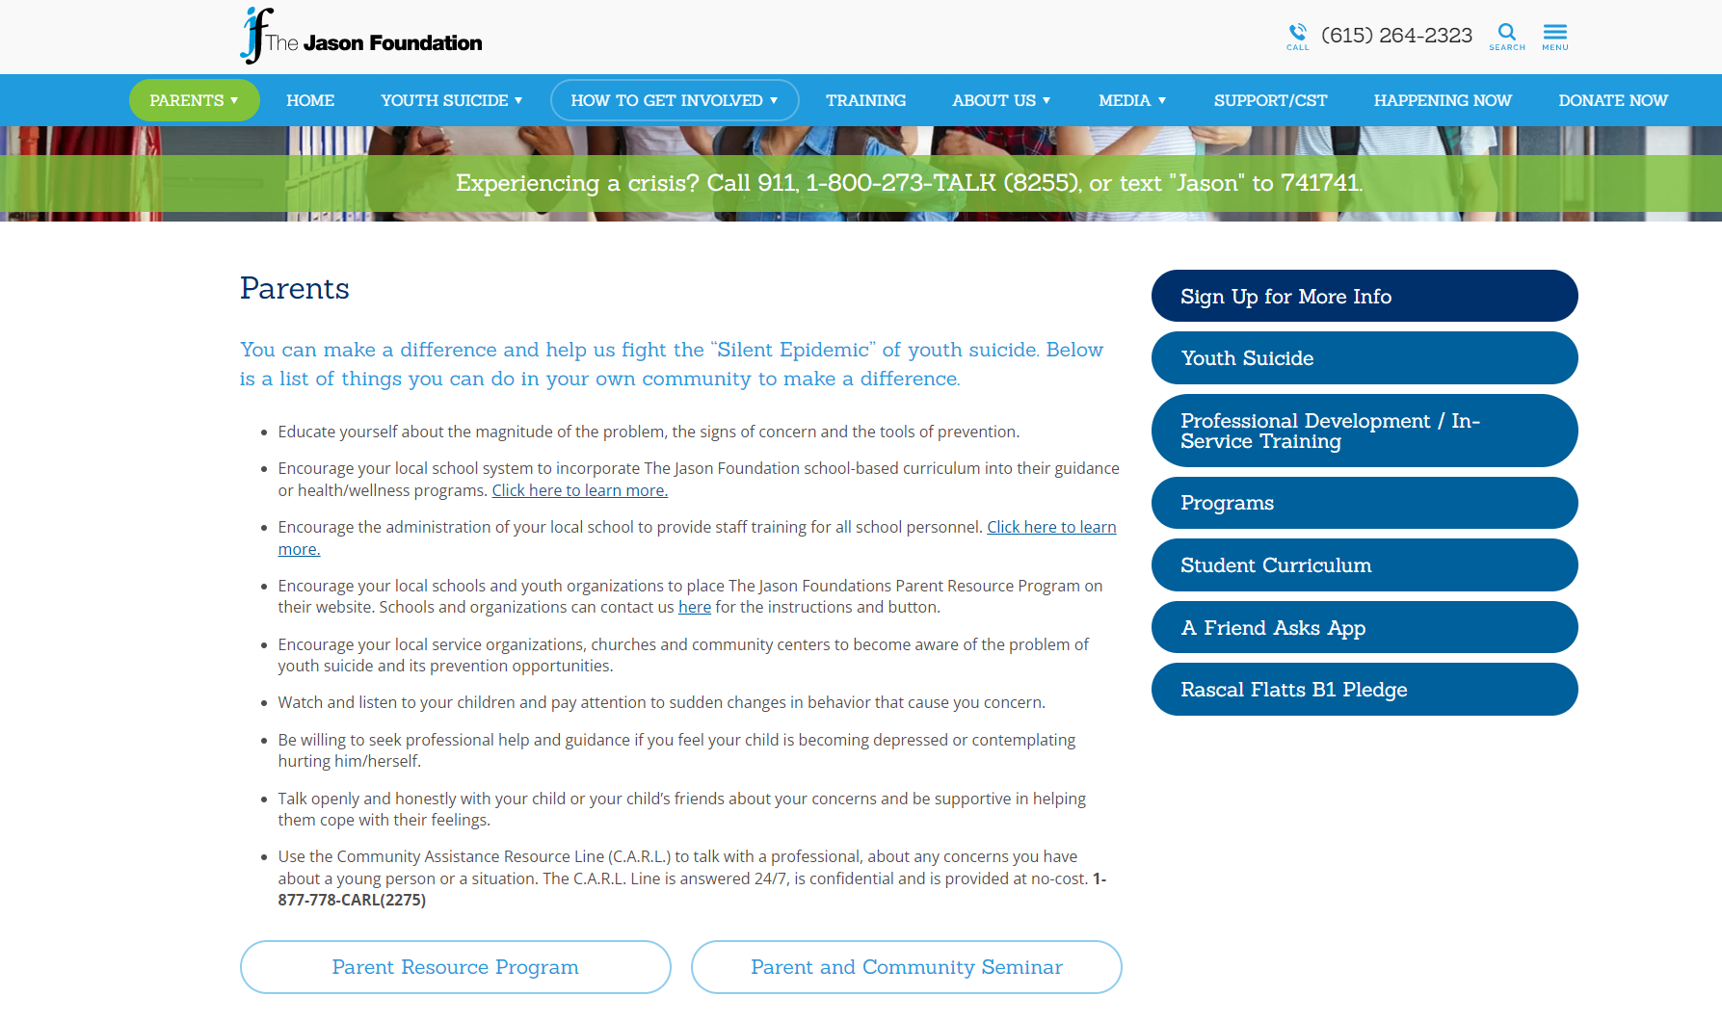
Notes:
Parents

Slide 10
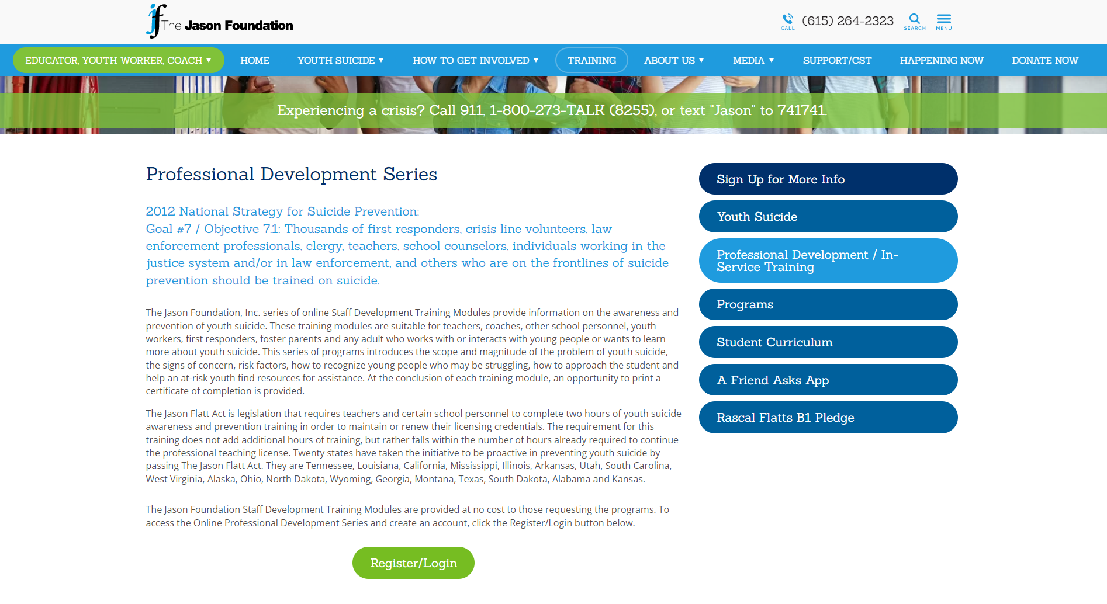
Notes:
Professional Development for Teachers, Coaches and Professionals

Slide 11
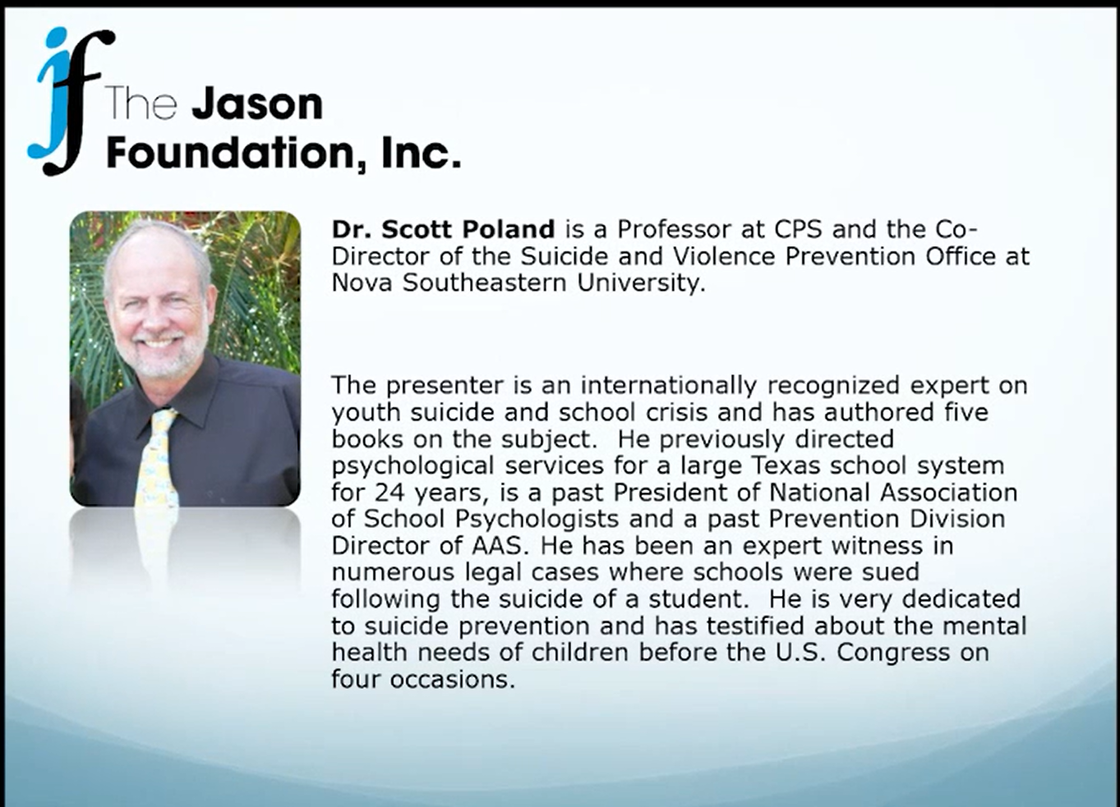
Notes:
This portion of the presentation is taken from the Non-Suicidal Self-Injury Professional Development course of the Jason Foundation.

Slide 12
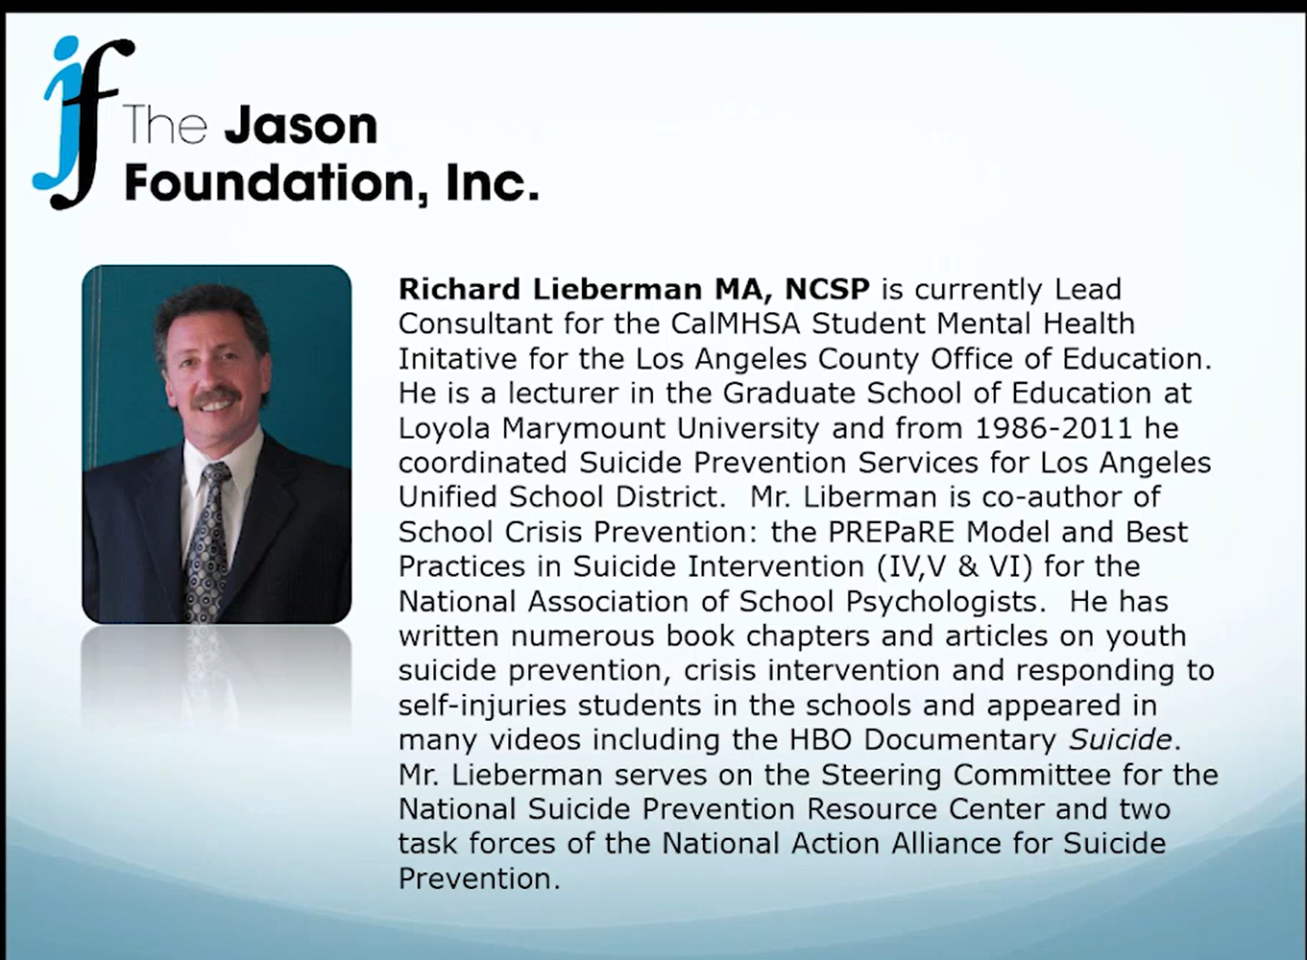

Slide 13
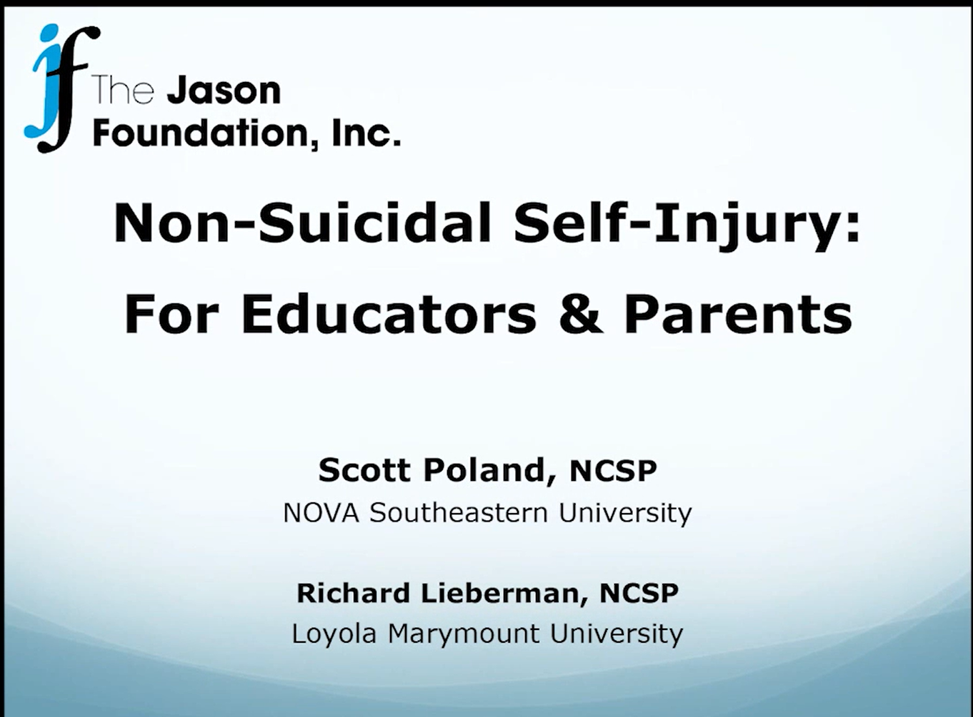
Notes:
800 calls per year – 50% were from Elementary Schools. 1 out of 4 were about NSSI.

Slide 14
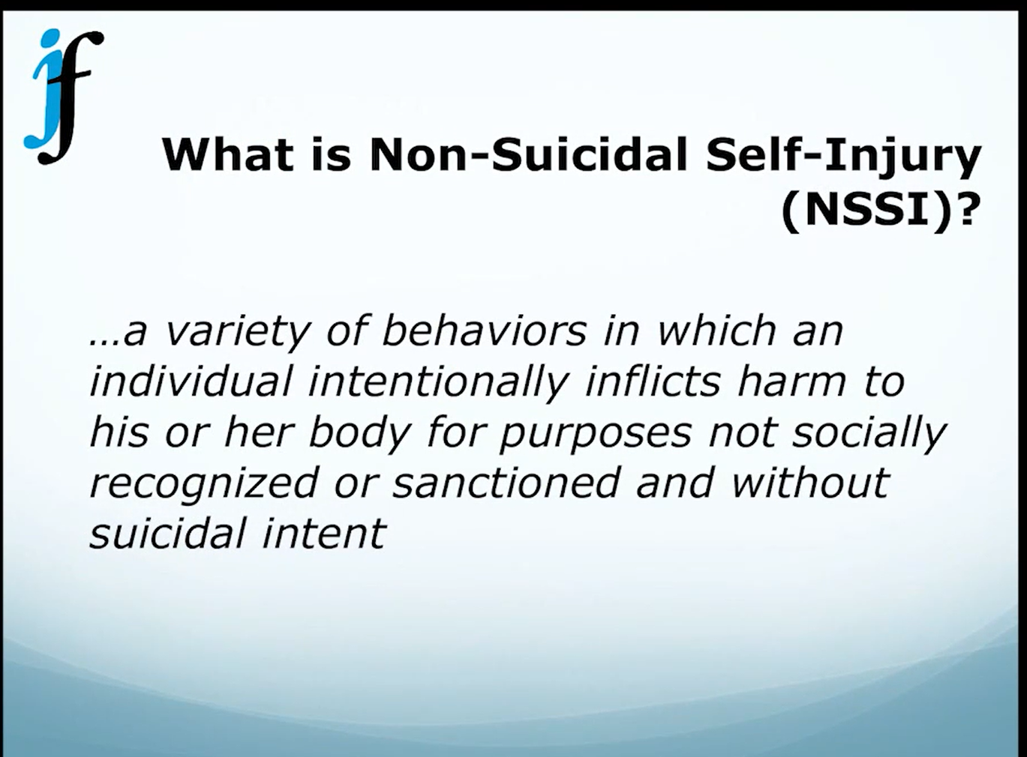

Slide 15
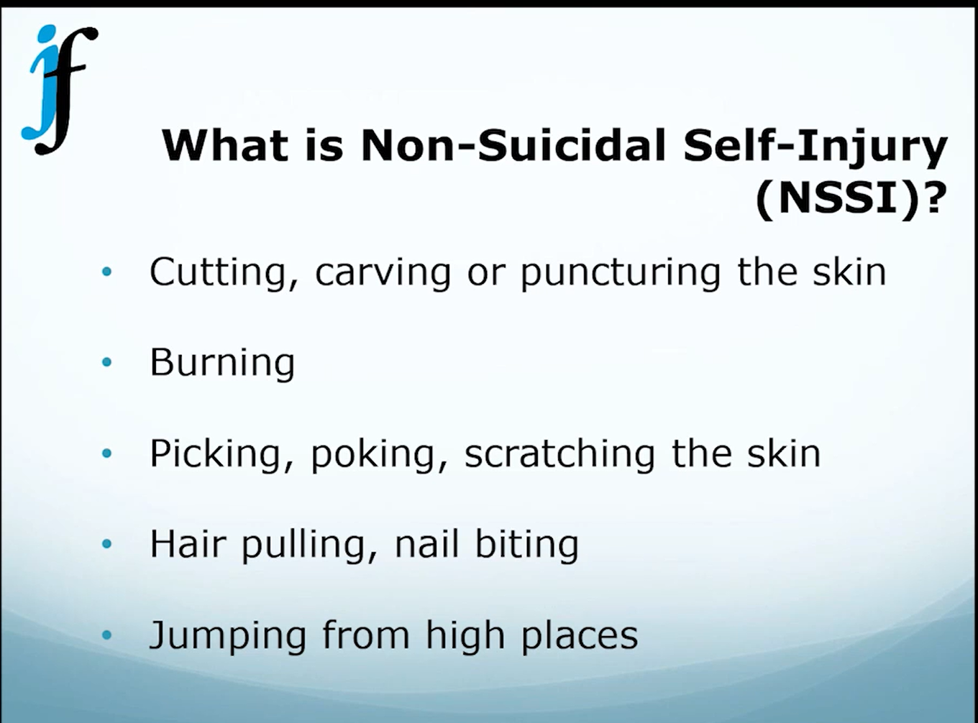
Notes:
Crisis: See through a developmental lens and a cultural lens. In elementary school, evenly divided between males and females, maybe slightly more males. By high school, predominantly females and 3 out of 4 will use cutting or burning. Contagious –”rite of togetherness. “ Fifth and sixth graders. Way to connect with a more powerful kid.

Slide 16
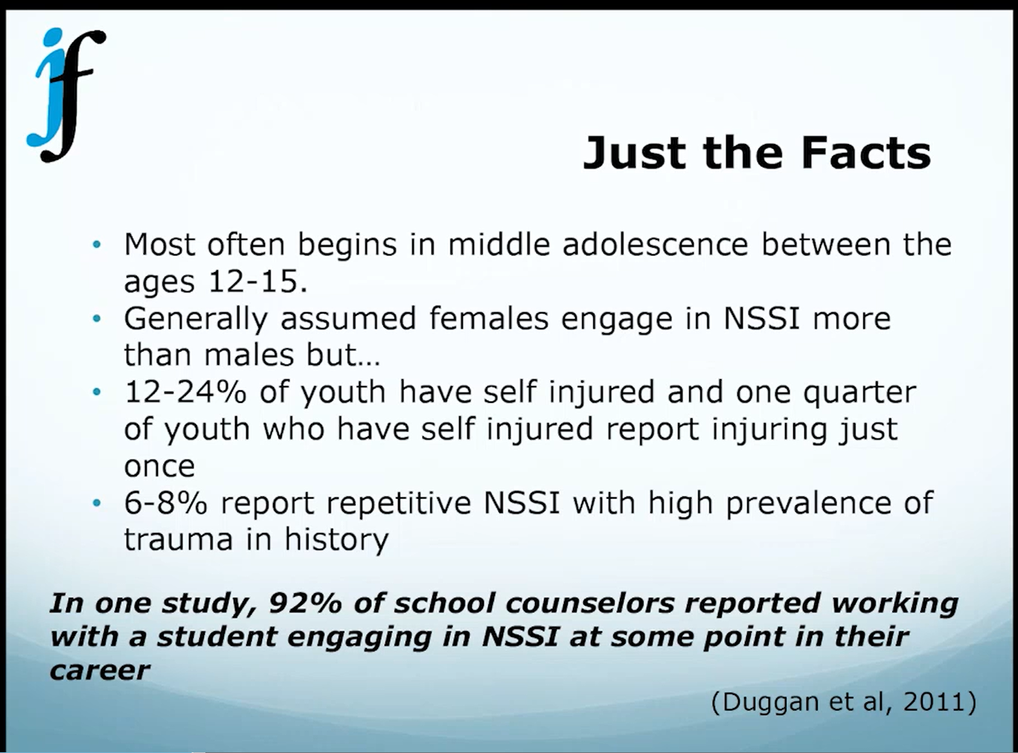
Notes:
Is this behavior addictive as a way to feel better. Cornell Self-Injury Clinic has handouts for staff and for parents.

Slide 17
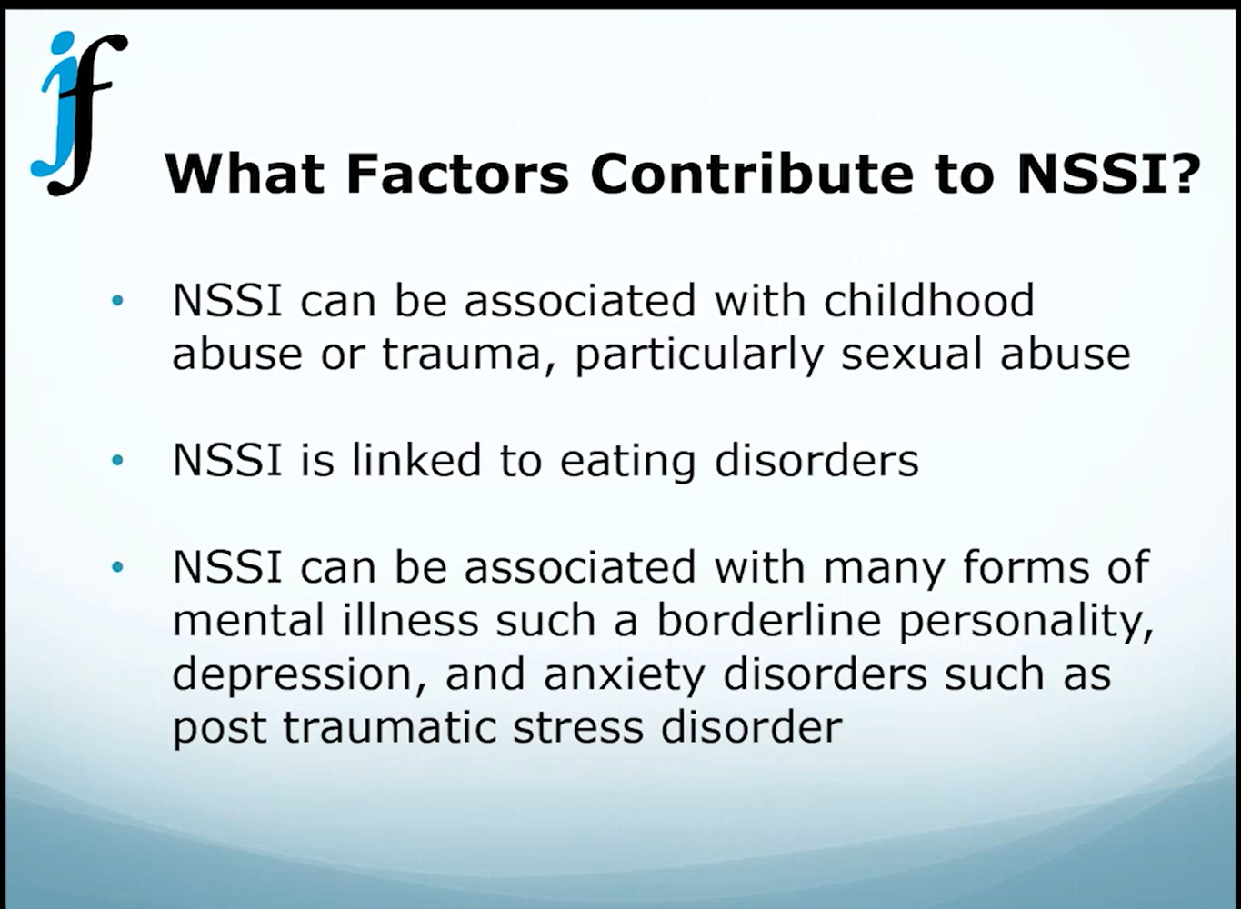
Notes:
50 – 60 % Trauma-related. 1 out of 3 with eating disorders have history of self injury. Attempt to get control of distressing thoughts. Cutting activates the opioid system in the body. Releases endorphins compulsive vs. impulsive behaviors. Thoughts setting emotions out of order.

Slide 18
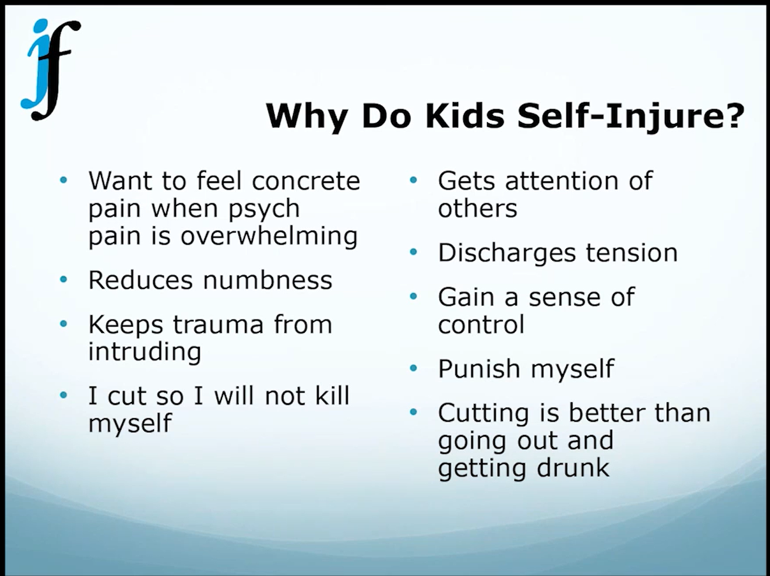
Notes:
Self blaming thoughts: “I am bad.”

Slide 19
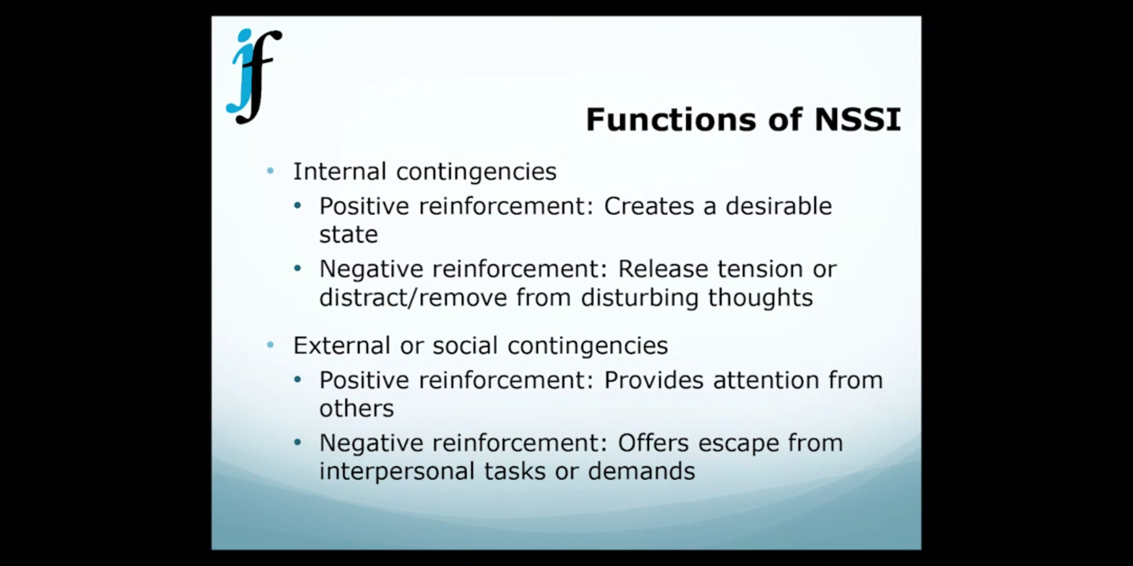
Notes:
Opioid system gives endorphin hit, but it is diminishing. There’s an alpha, who will be hospitalized. The moderate risk kid – secretly made a suicide attempt. Boys may be in early stage of antisocial personality disorder. Girls may be in early stages of a Borderline Personality Disorder.

Slide 20
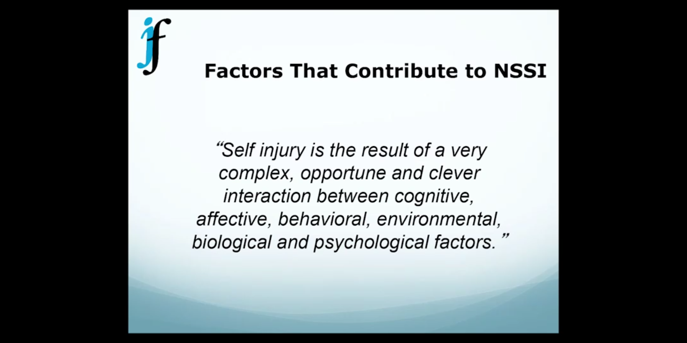
Notes:
Precipitating events, Adverse Childhood Events (ACEs) Biology + Trauma

Slide 21
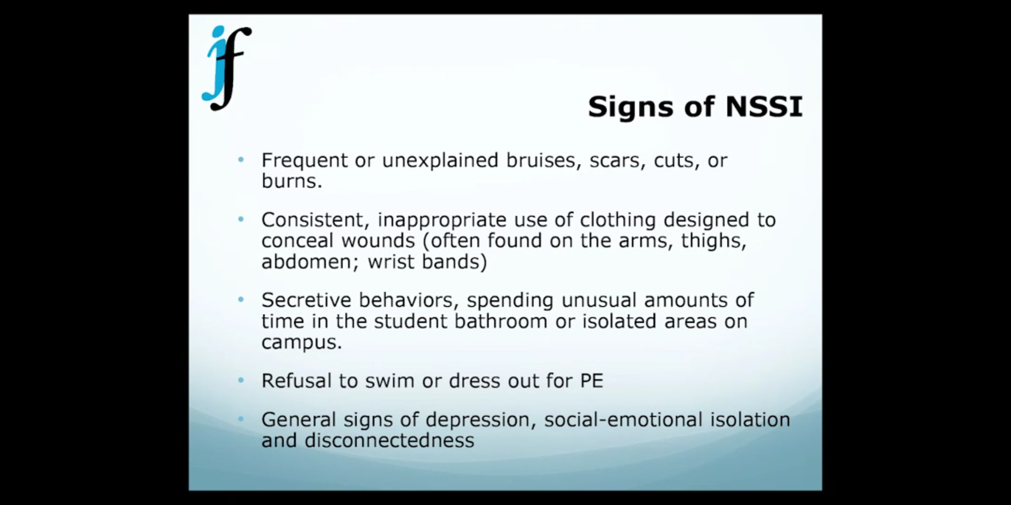
Notes:
Watch out for sharing implements as a bonding act.

Slide 22
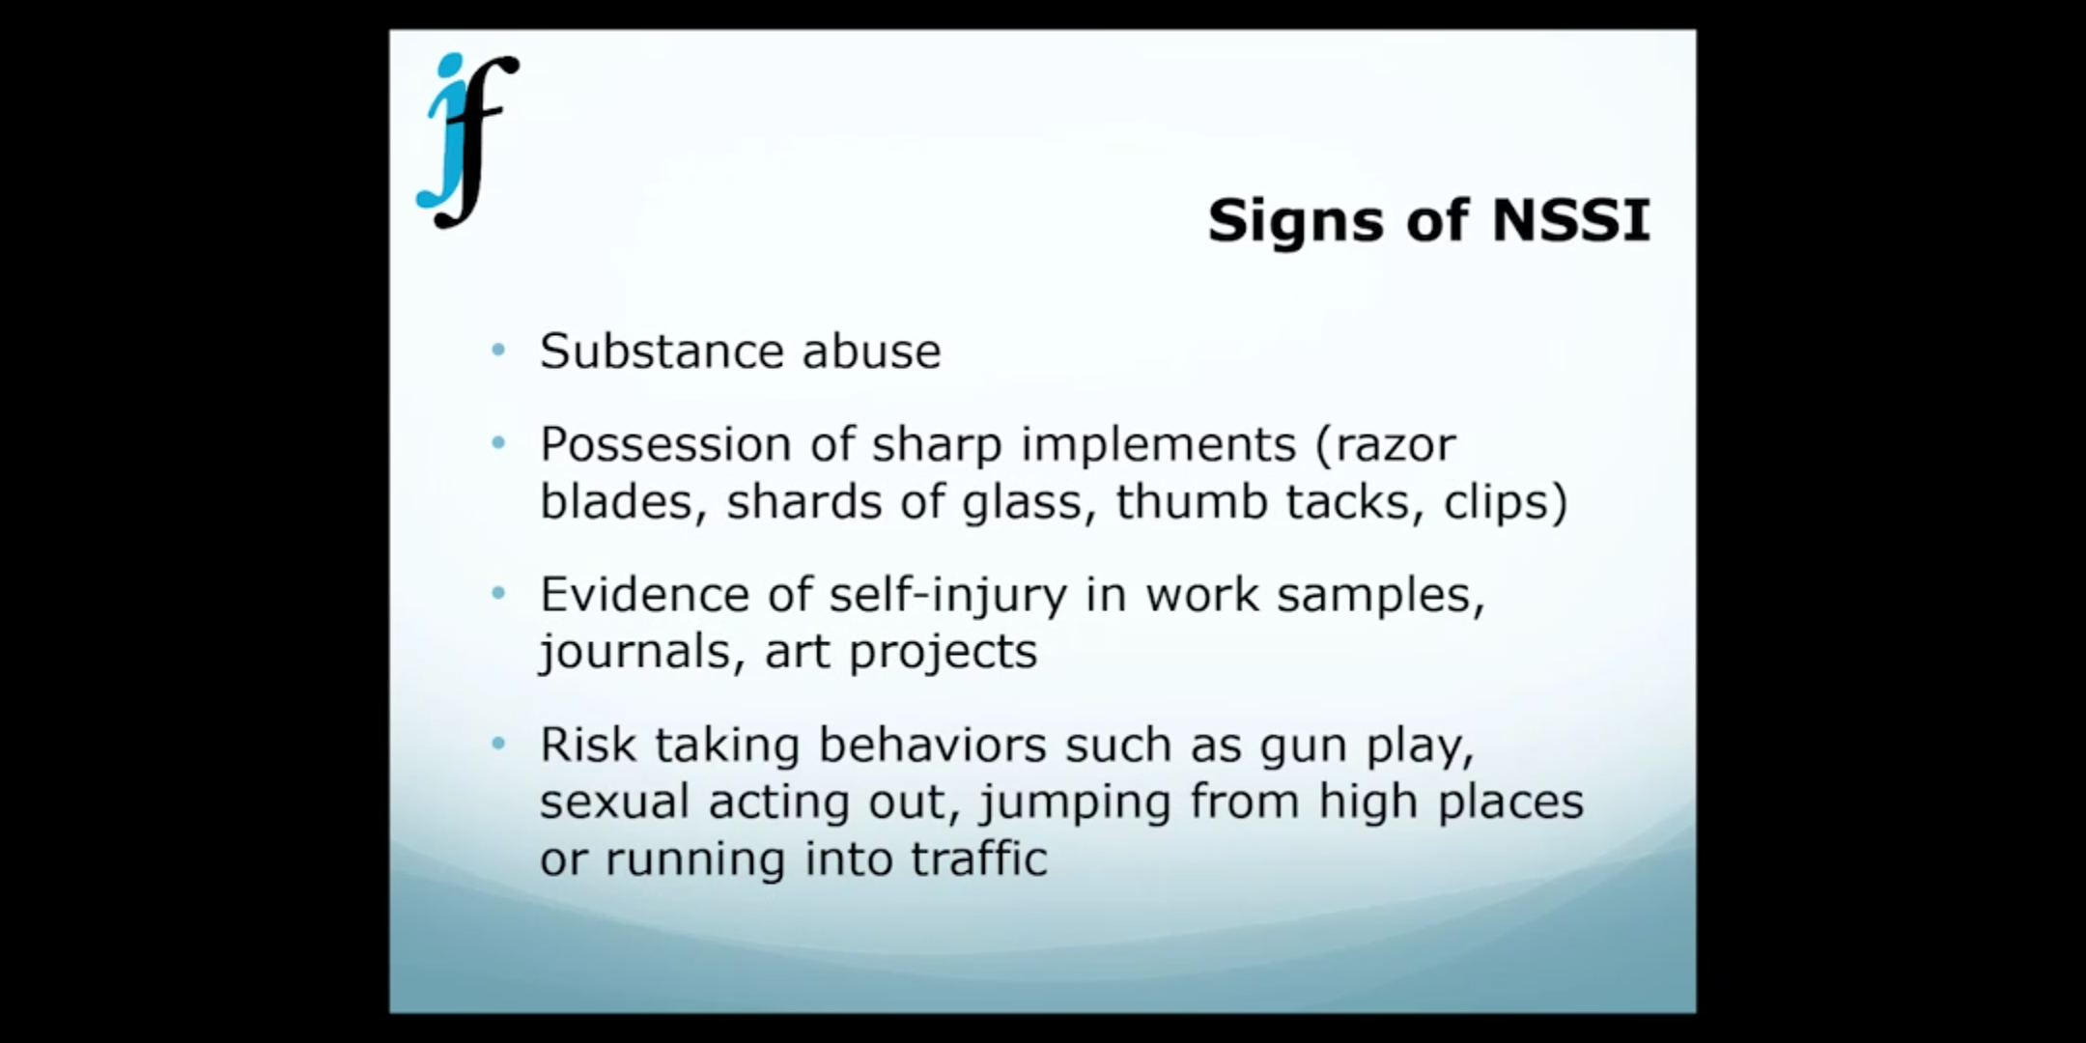
Notes:
Younger kids running into traffic. Older kids, playing with guns, dangerous stunts…

Slide 23
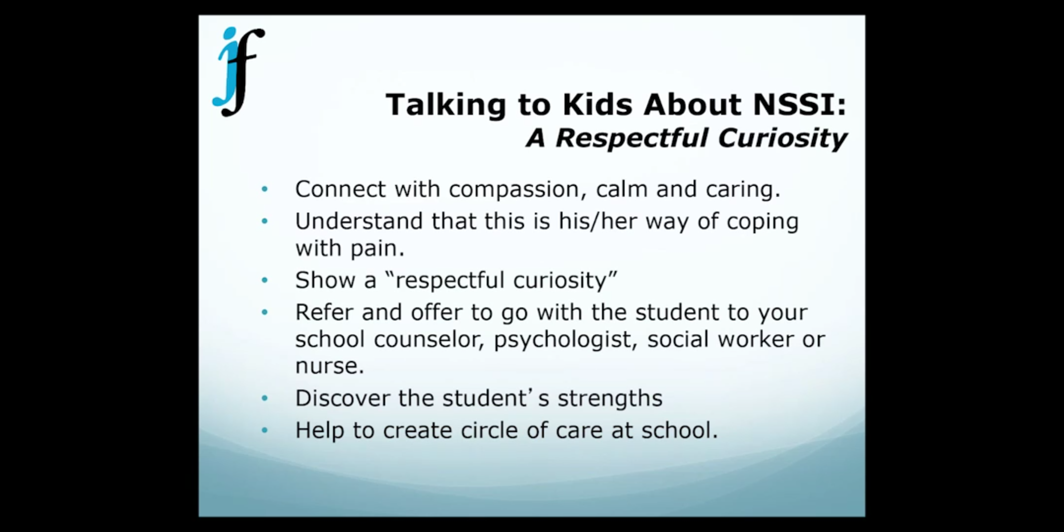

Slide 24
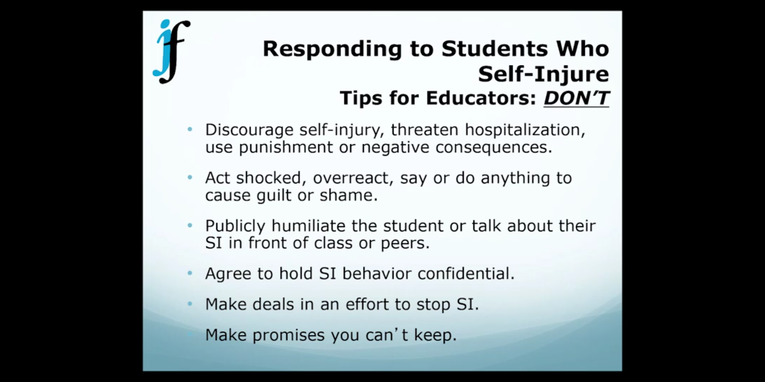
Notes:
All school employees are mandated reporters – a call must be made to parents;, but should be made by a member of the crisis team. Wrong approach may lead to suicide attempt.

Slide 25
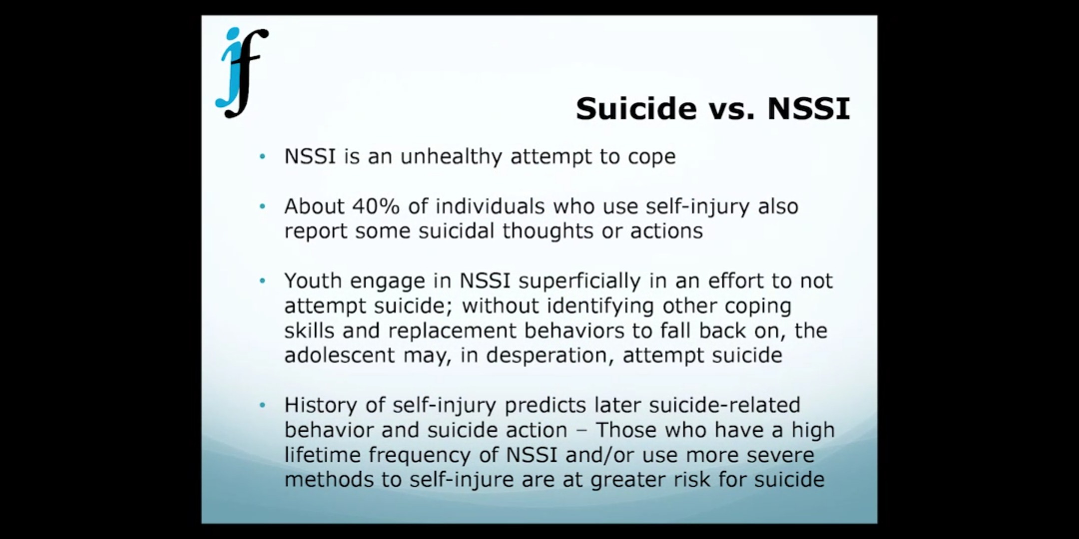

Slide 26
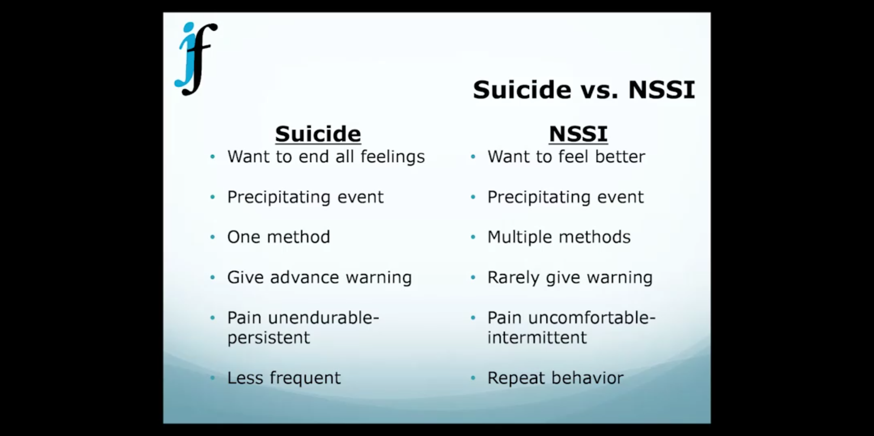
Notes:
Low belongingness / Perceived burdensomeness / Habituation – Repeated self-injury. Precipitating event: Extreme legal situations, big argument, breakup. (42:00) Trigger log, journaling.

Slide 27
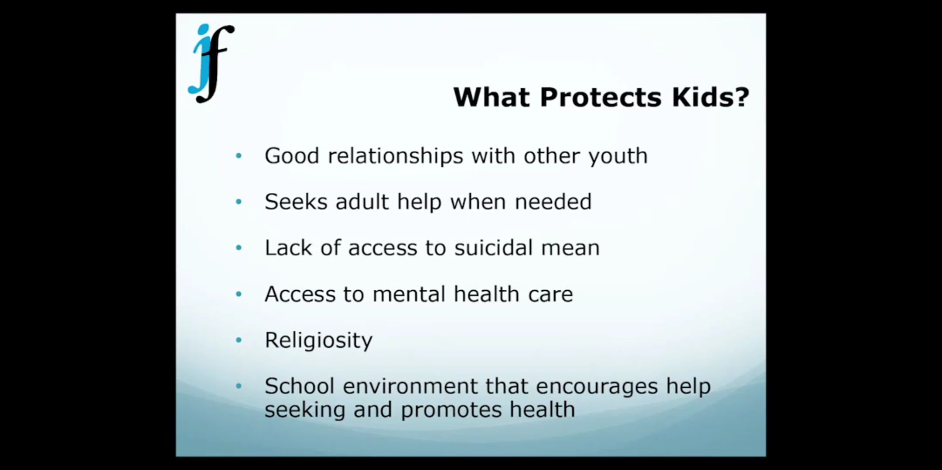
Notes:
Warning: disturbed kids relate to other disturbed kids. Care.

Slide 28
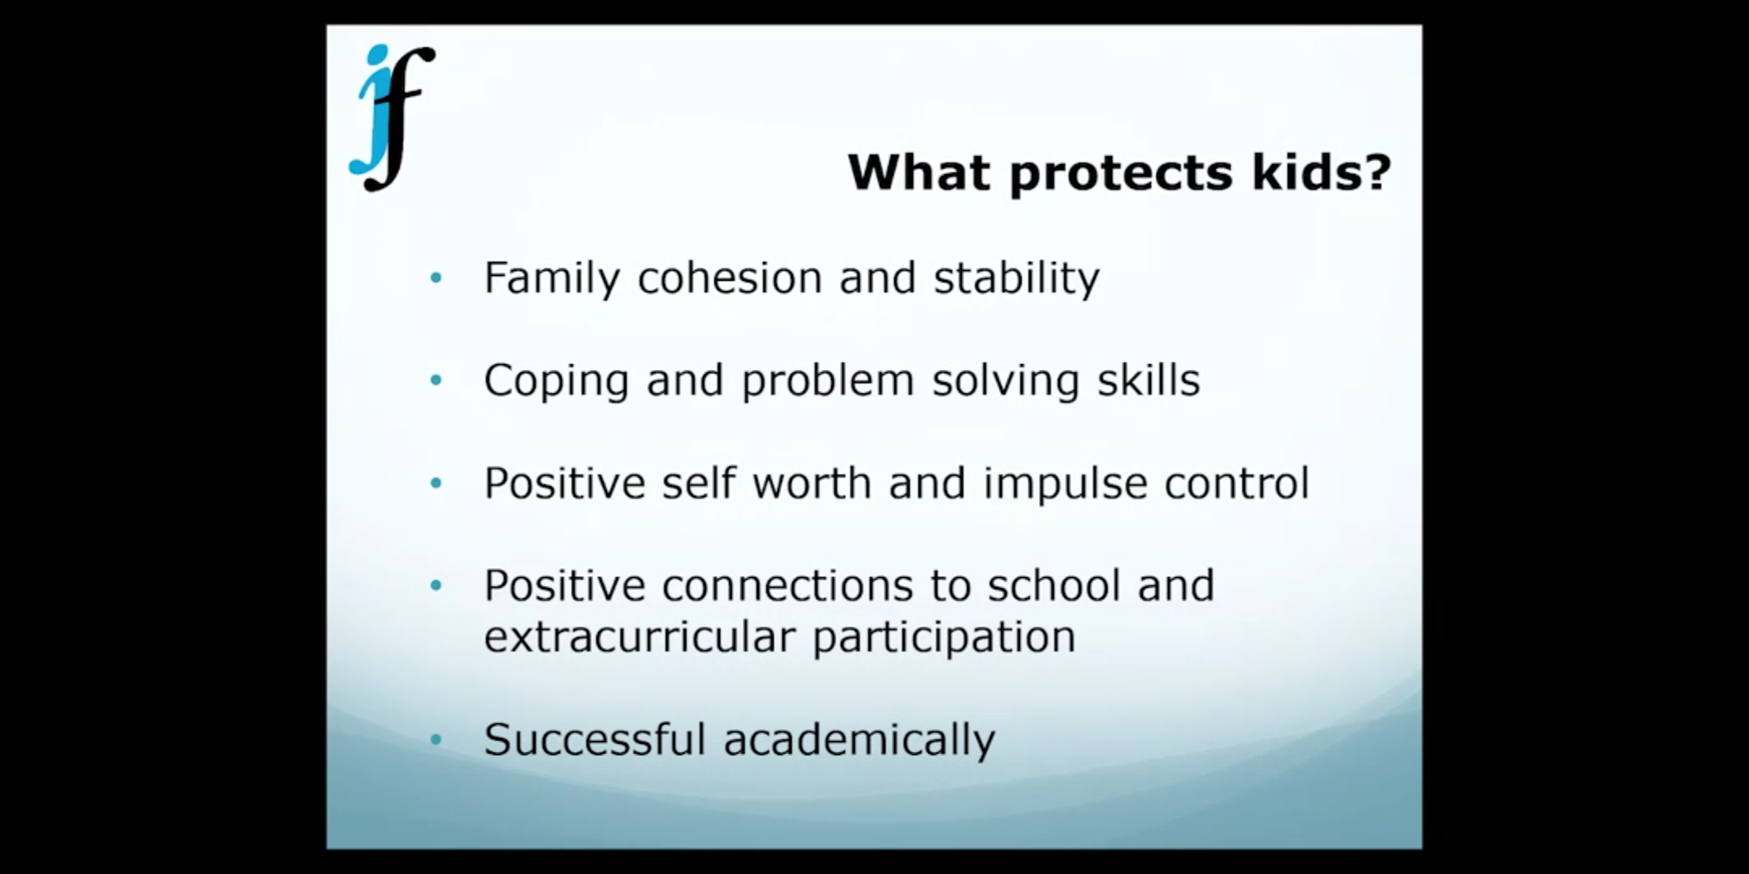
Notes:
Make a pact don’t dis partner and put kid in the middle.

Slide 29
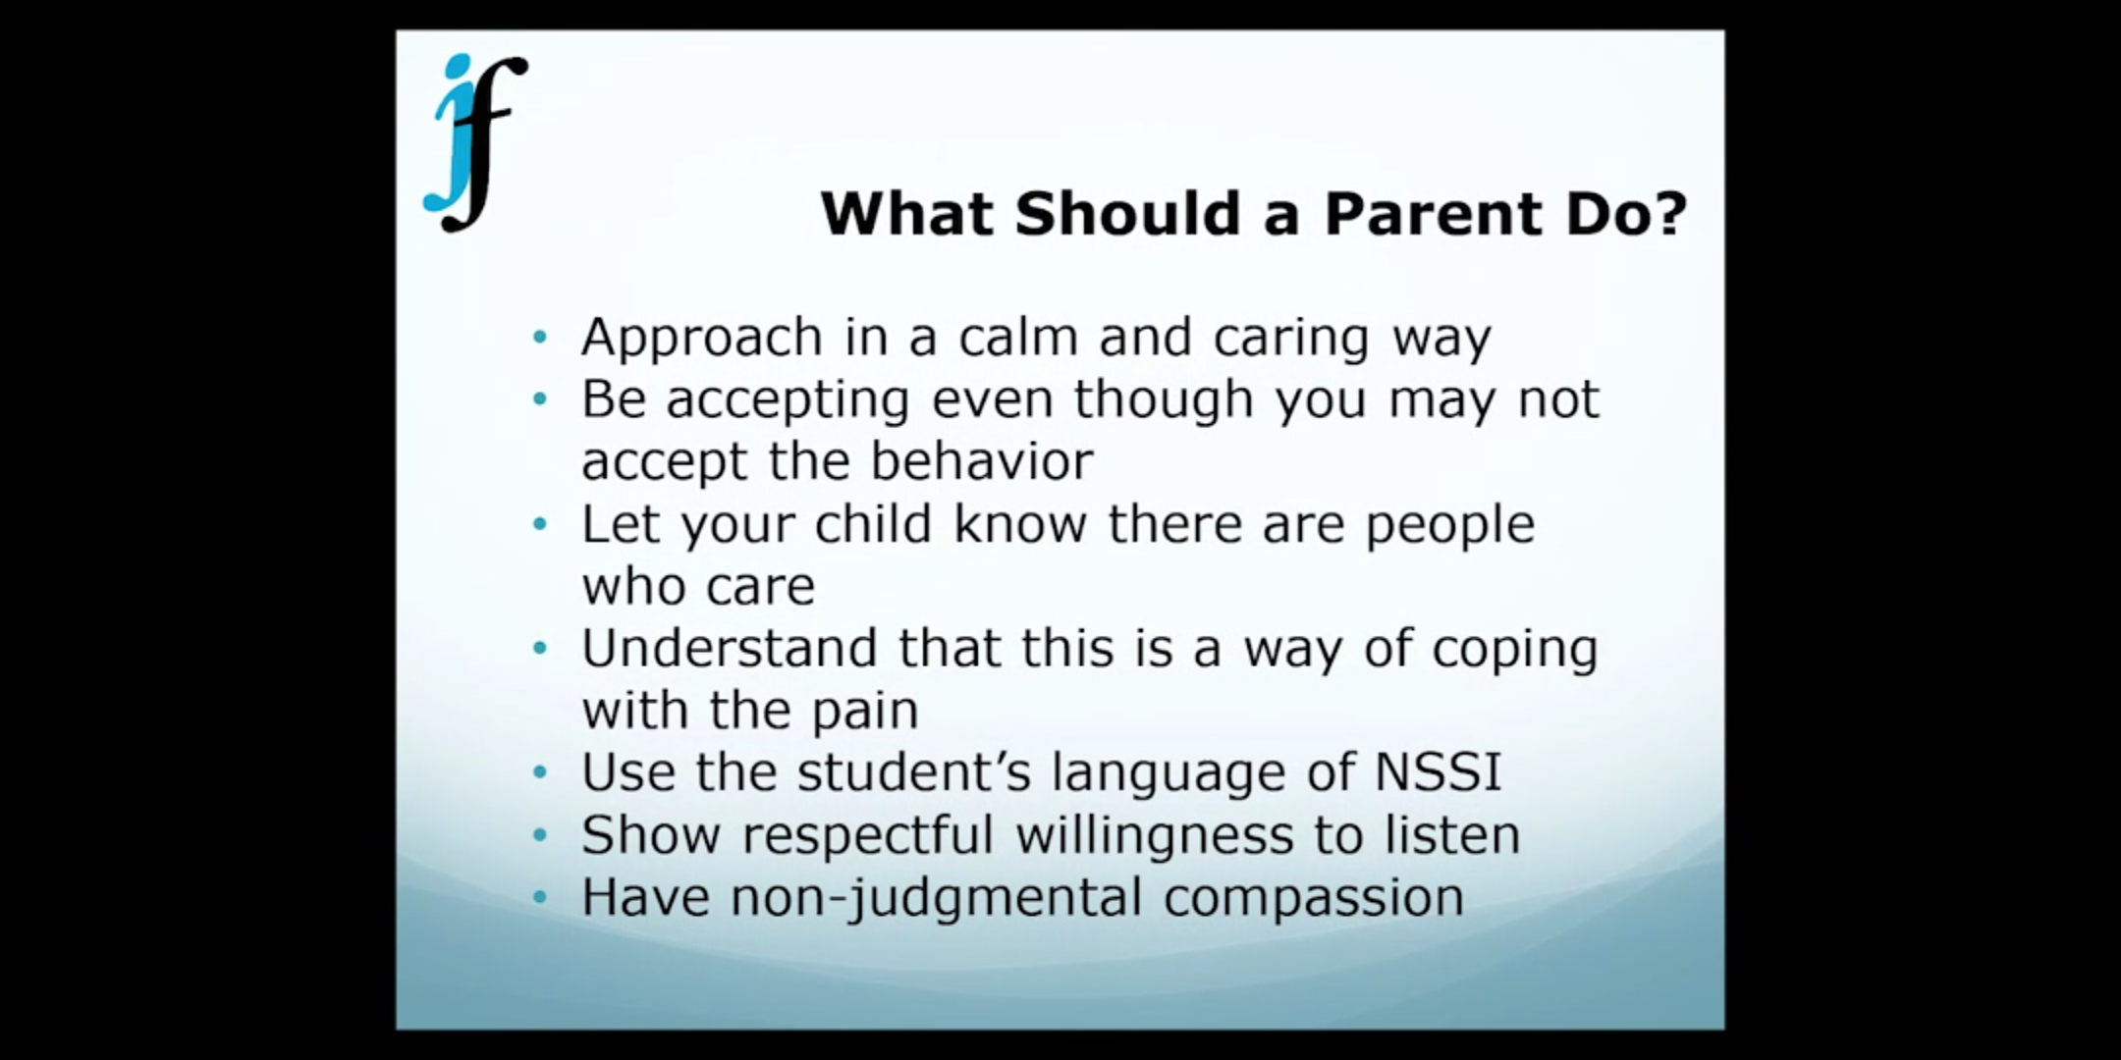
Notes:
Help the child get control of the behavior. Forbidding friend does not work well. Parents high on denial. Respectful curiosity.

Slide 30
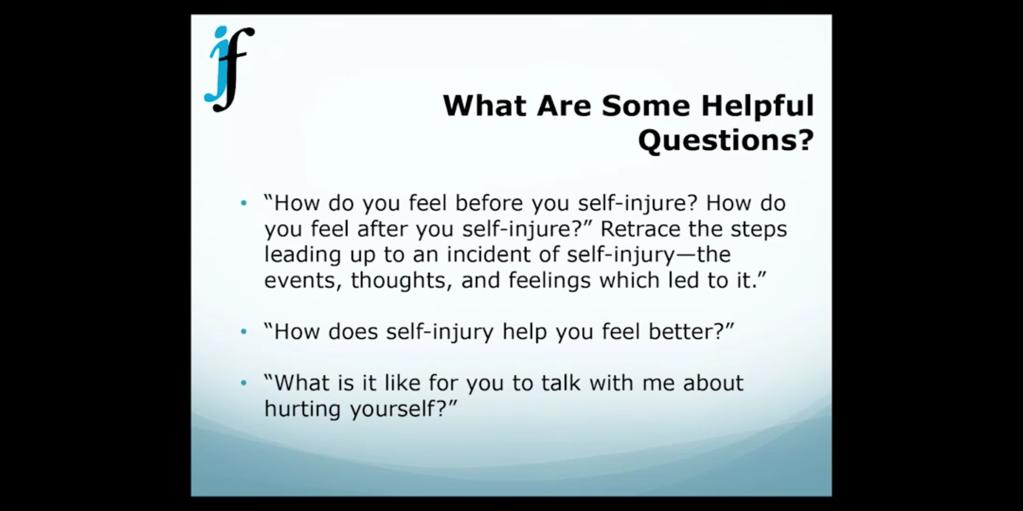
Notes:
Mandated reporter responsibility.

Slide 31
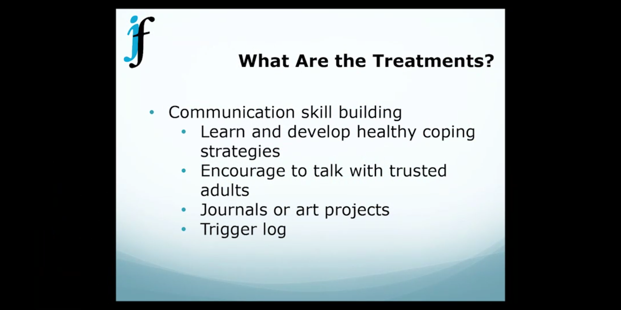
Notes:
No cut contract doesn’t work. Work to reduce the behavior.

Slide 32
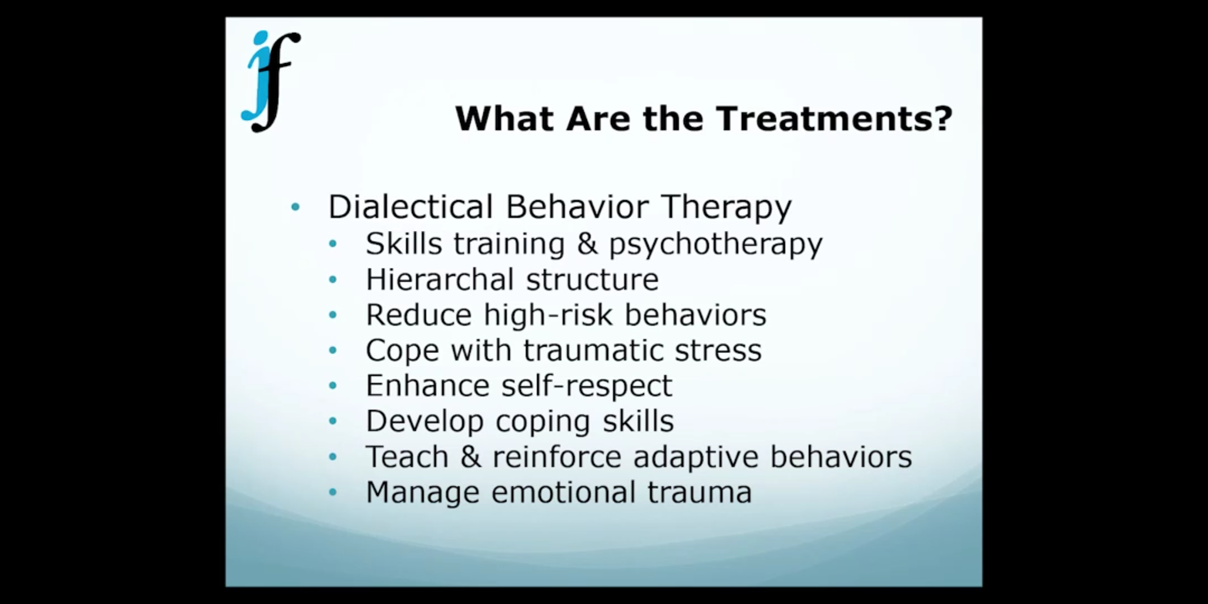
Notes:
Contact therapist in difficult moments. Social skills training sessions. Marsha Linahan , University of Washington.

Slide 33
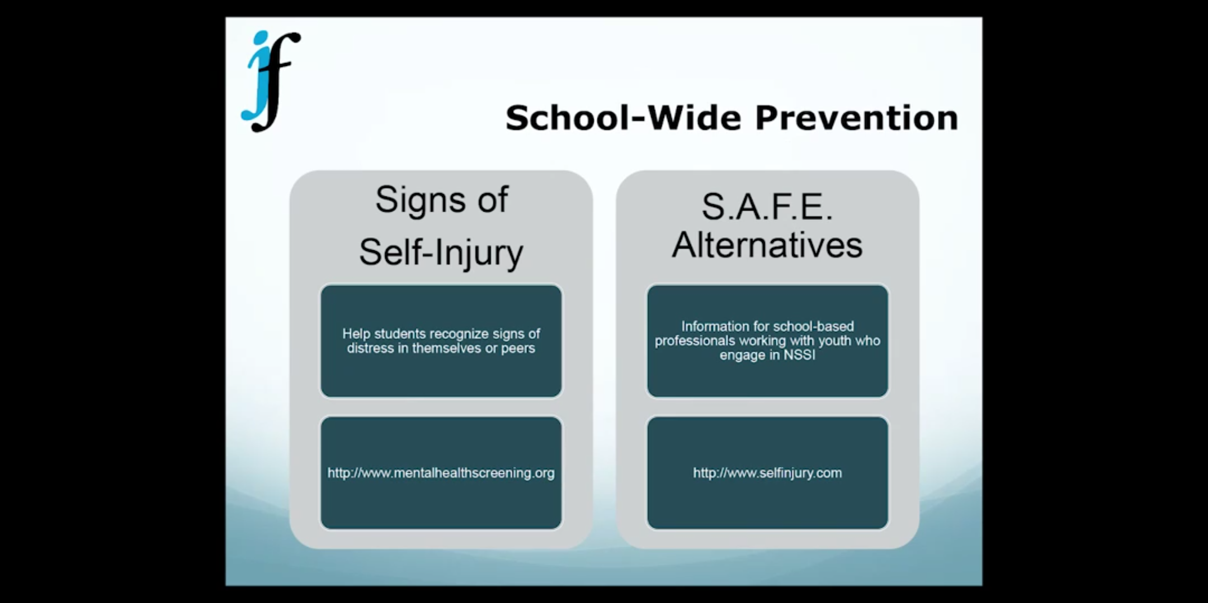

Slide 34
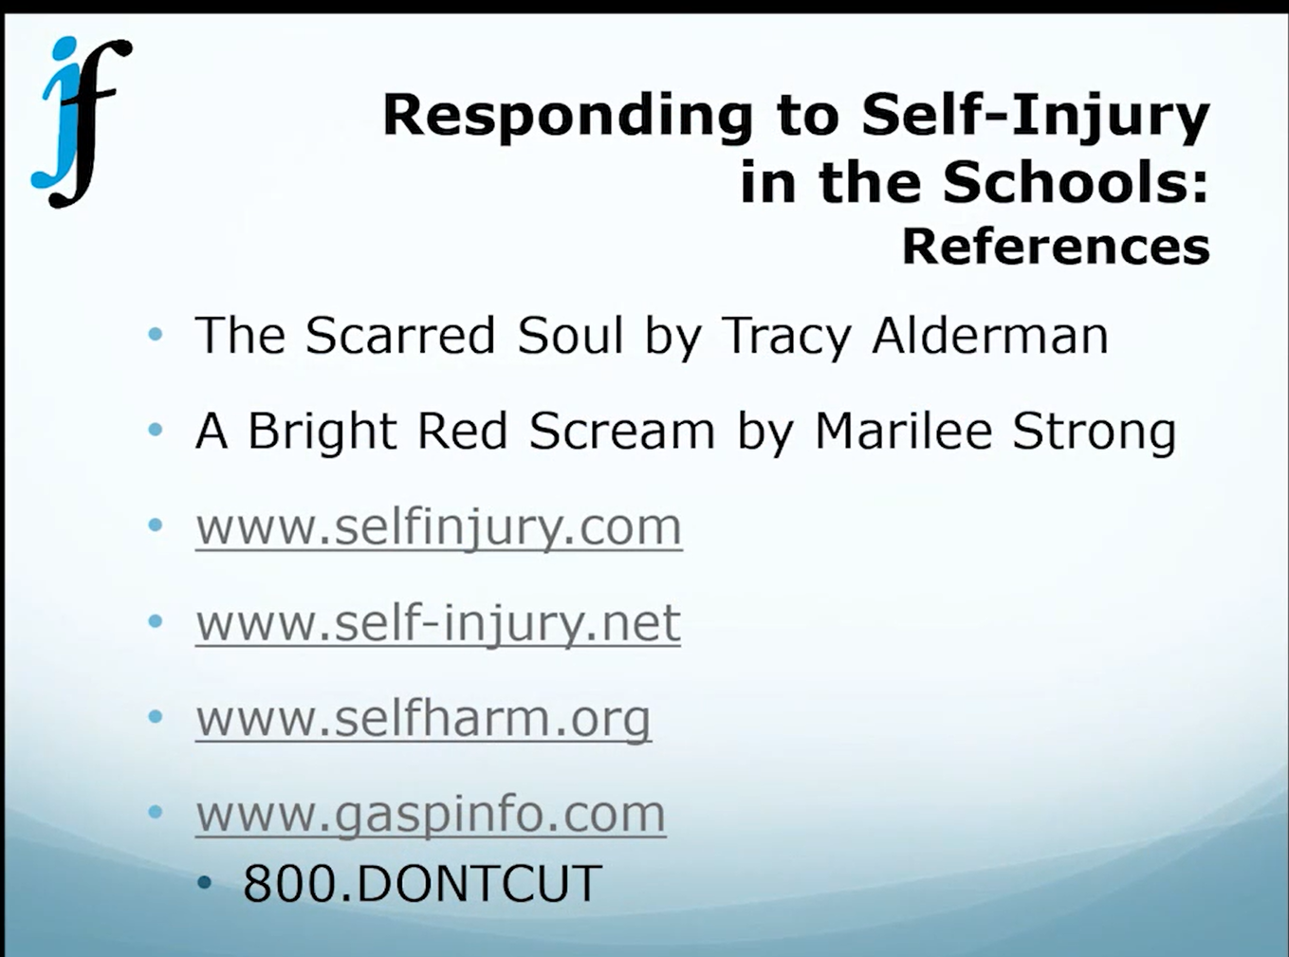
Notes:
Garrett Lee Smith Memorial Act - died by suicide

Slide 35
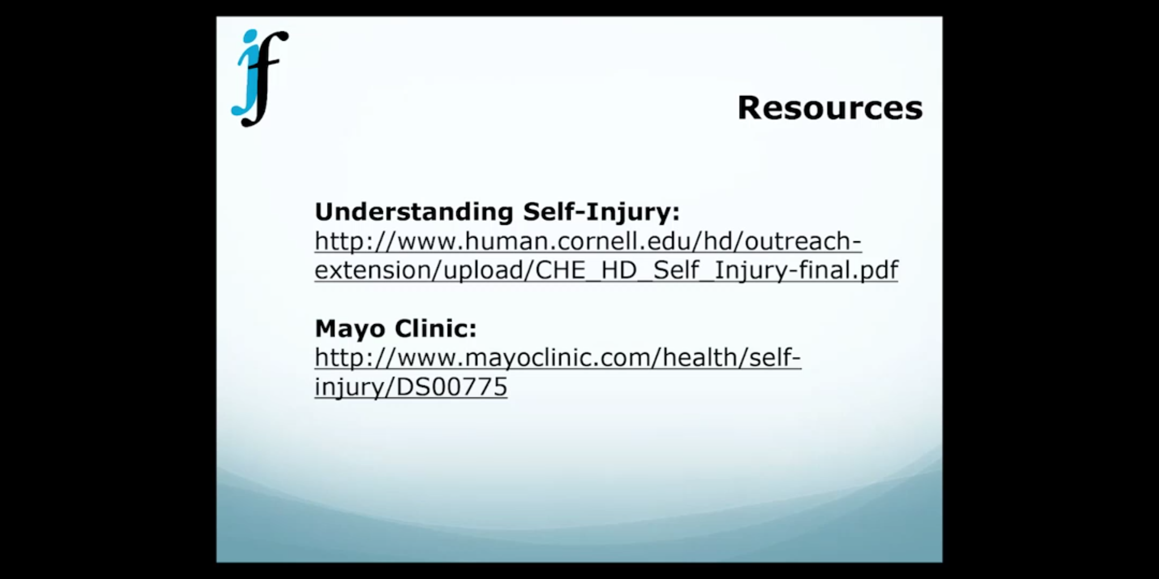
Notes:
New location for the Cornell resources: http://www.selfinjury.bctr.cornell.edu/about-self-injury.html

Slide 36
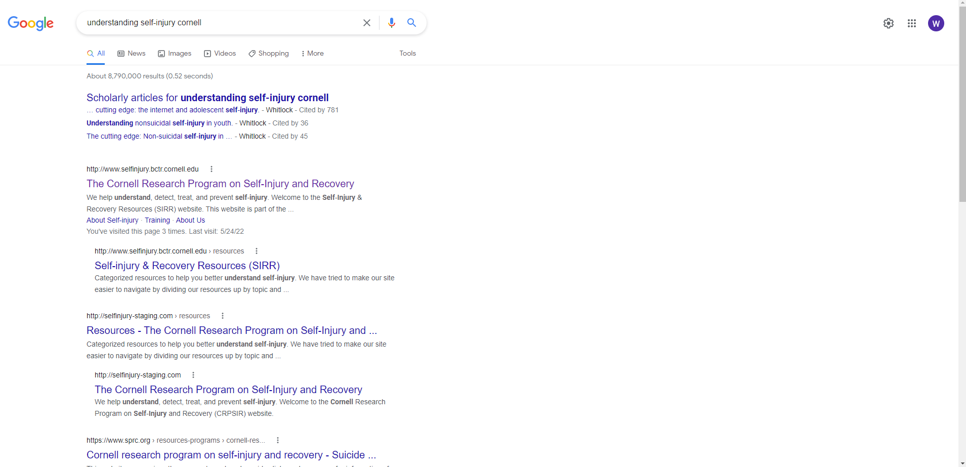

Slide 37
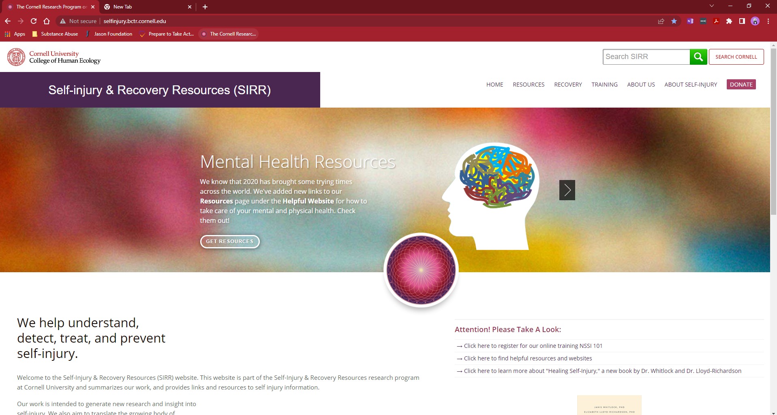

Slide 38
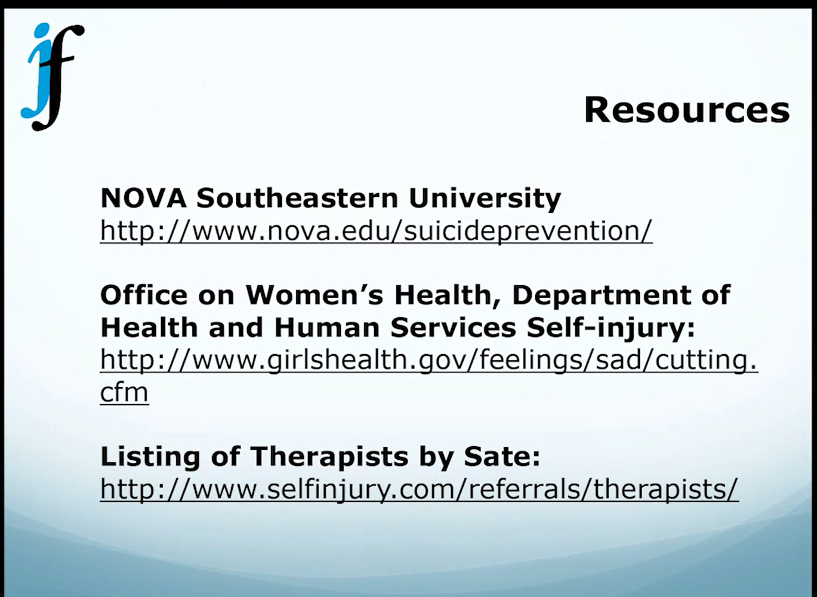
Notes:
Video at NOVA Southeastern University featuring former self-injurers. Must be very careful when talking to children about this subject.

Slide 39
